Slide 1
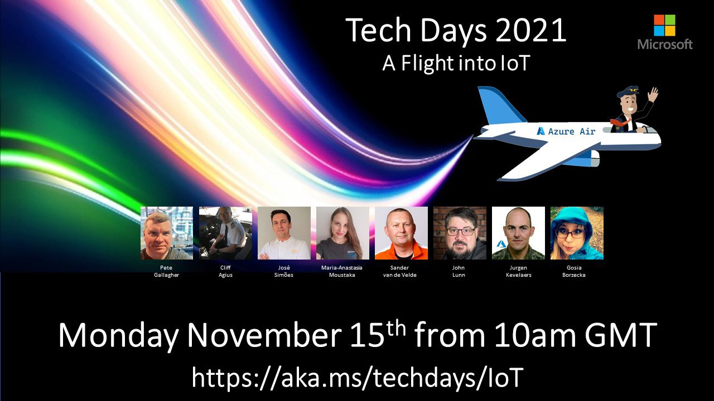
Time Series Insights
Tech Days 2021
Sander van de Velde
MVP Azure IoT
IoT Solution Architect at Atos
@svelde

Slide 2
Airplane data is arriving at the IoT Hub, what now?
Questions, Questions, Questions
From a Data Scientist perspective
I want to see if there is a certain trend in the data
I have a suspicion about the existence of certain anomalies that I would like to see confirmed
Do I have a solid data base for certain Enterprise reports?
From an Operator perspective
Is there any telemetry coming in?
Give me a sneak peak. What telemetry is currently arriving?
Can I validate the telemetry for a potential problem?
Can I compare data of one flight with one or more previous flights?
Can I look at all telemetry of a specific flight, even if that was 15 years ago? In seconds?
@svelde

Slide 3
We need an End-to-end analytics platform
To monitor, analyze, and visualize your (industrial) IoT data at scale
Storing the incoming data for historical purposes
Visualizing using line charts, heat maps, scatter maps, shifting time for comparison, added calculations
Preliminary investigations to check quality of ingested data or confirm suspicions
Basis alerts (e.g. when no data is ingested anymore)
and more…
… something like an Operational Historian in the cloud
@svelde

Slide 4

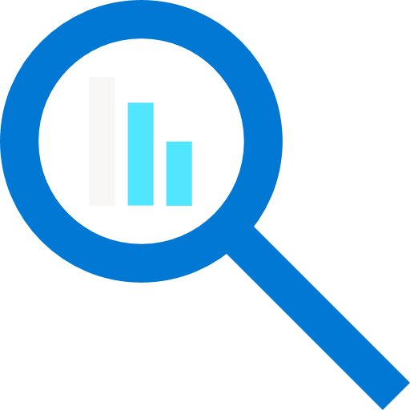



Azure Time Series Insights (TSI)
A fully managed (platform as a service - PaaS) solution built for IoT
Ingest, process, store, query, and visualize
highly contextualized, time-series-optimized, IoT data at scale
Connect to a variety of data solutions
using TSI’s flexible data platform
Use rich analytics APIs and UX
for ad-hoc exploration and operational intelligence
Use JavaScript SDK
for building custom analytics apps on the TSI platform
Automated scaling and pay-as-you-go pricing
Turn data into decisions with actionable real-time IoT insights
@svelde

Slide 5



Azure Time Series Insights pay-as-you-go high-level architecture
Ingest
Store
Model
Analyze
</>
COLD STORE ADLS Gen 2/ Azure Blob
Azure Event
Hub
Time Series Model
Time Series Query API
Time Series Insights Explorer
Power BI Connector
3rd PARTY APPS
Azure IOT
Hub
Azure Digital Twins
Ingestion processing
WARM STORE ADX
</>
TSM Update API
Timeseries data
API requests/returns
AI/ML workflow
@svelde

Slide 6

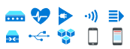


Uncovering the why:
Anomaly detection and diagnosis
Examples:
Understanding why equipment requires extra maintenance
Searching why inventory was damaged
Researching why production declined on an assembly line
Chasing down a defect in the supply chain process
3rd Party IoT apps using Time Series Insights APIs
Query API
Time Series Insights JavaScript SDK
IoT device, gateway, and application data
Azure IoT Hub
Time Series Insights
Time Series Insights Explorer
@svelde

Slide 7
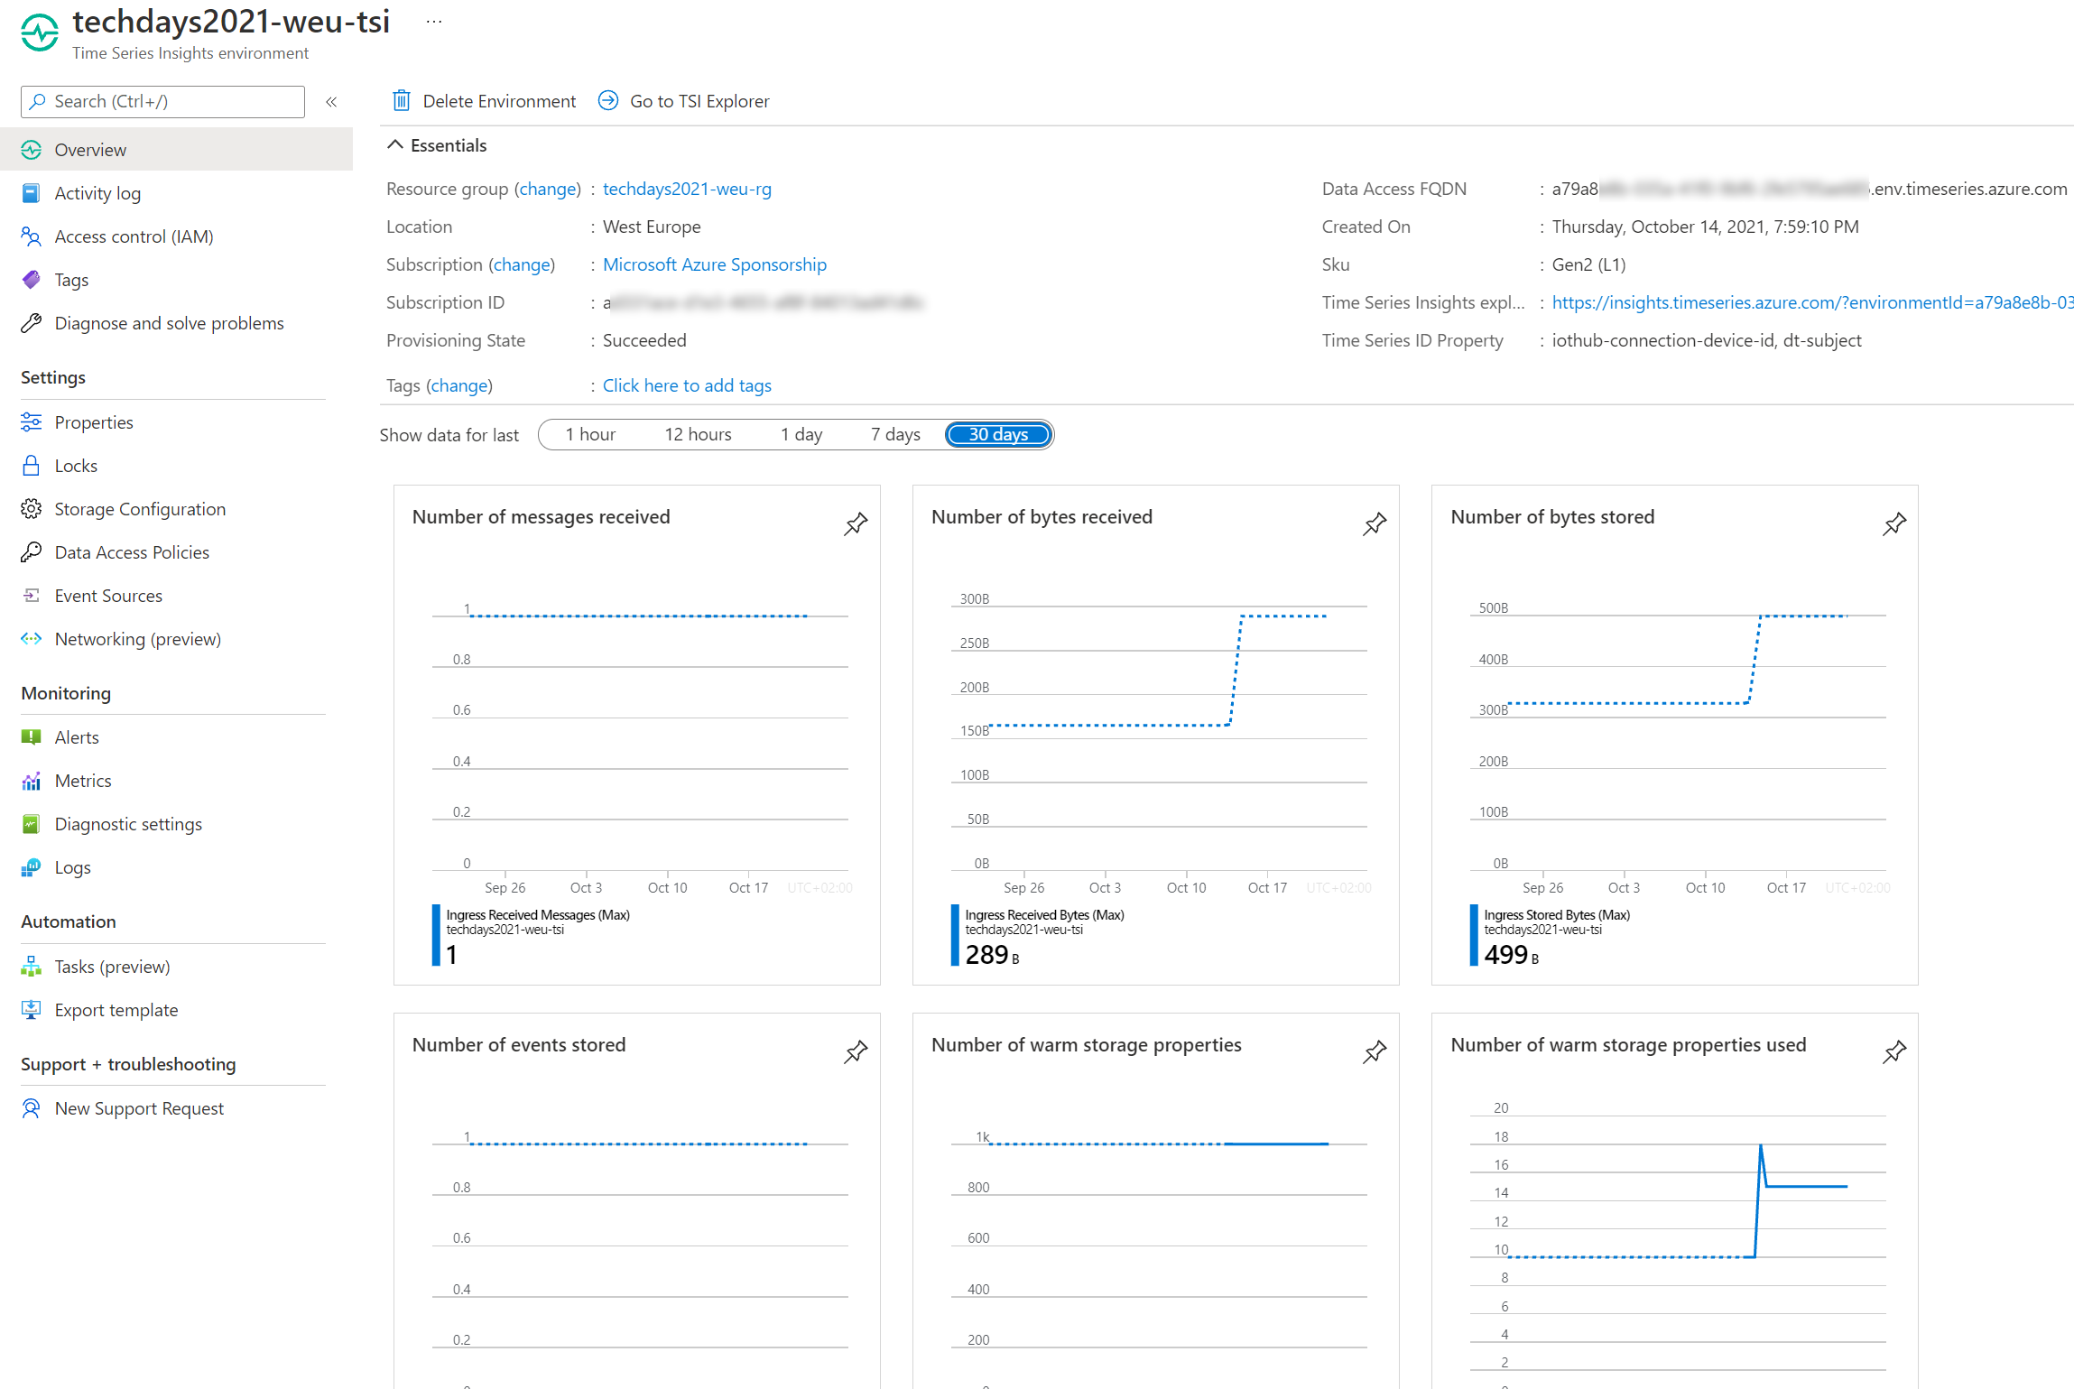
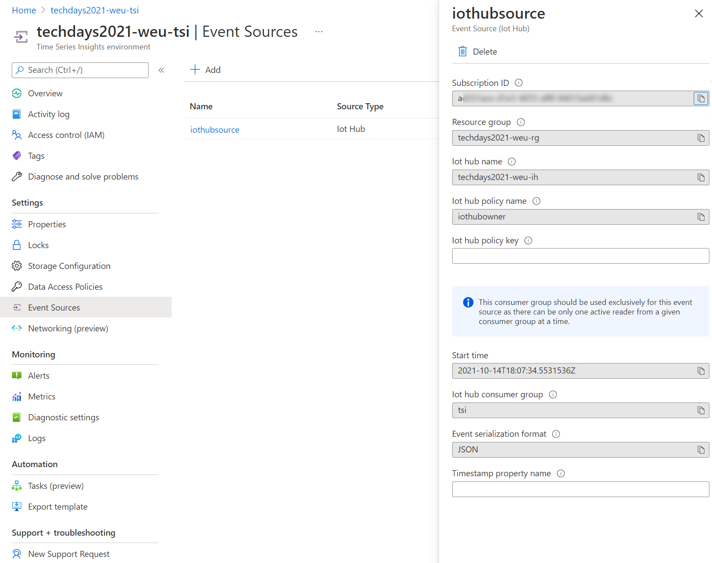
Demo
@svelde

Slide 8
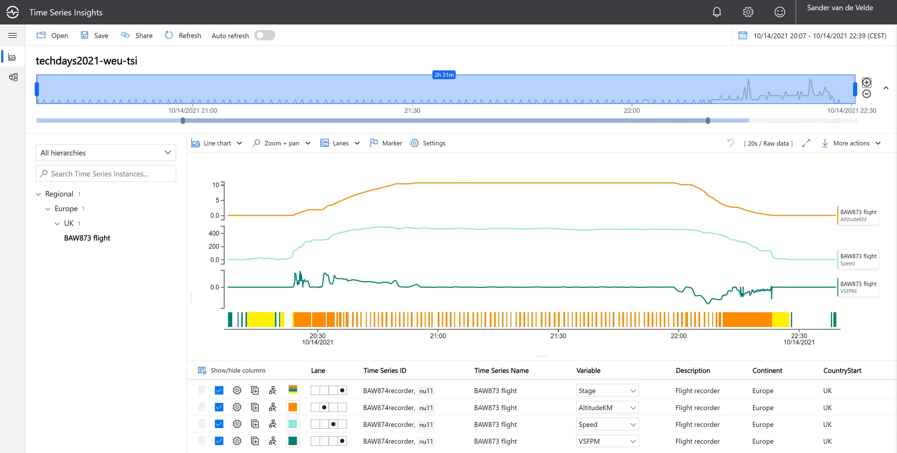
Demo
@svelde

Slide 9
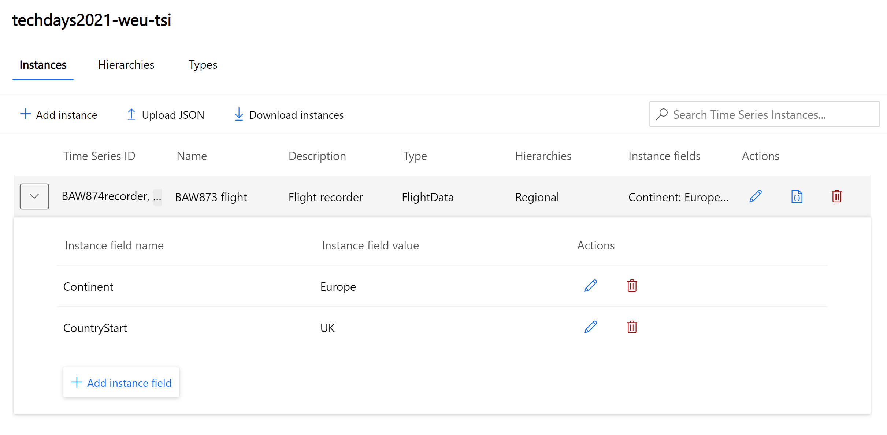
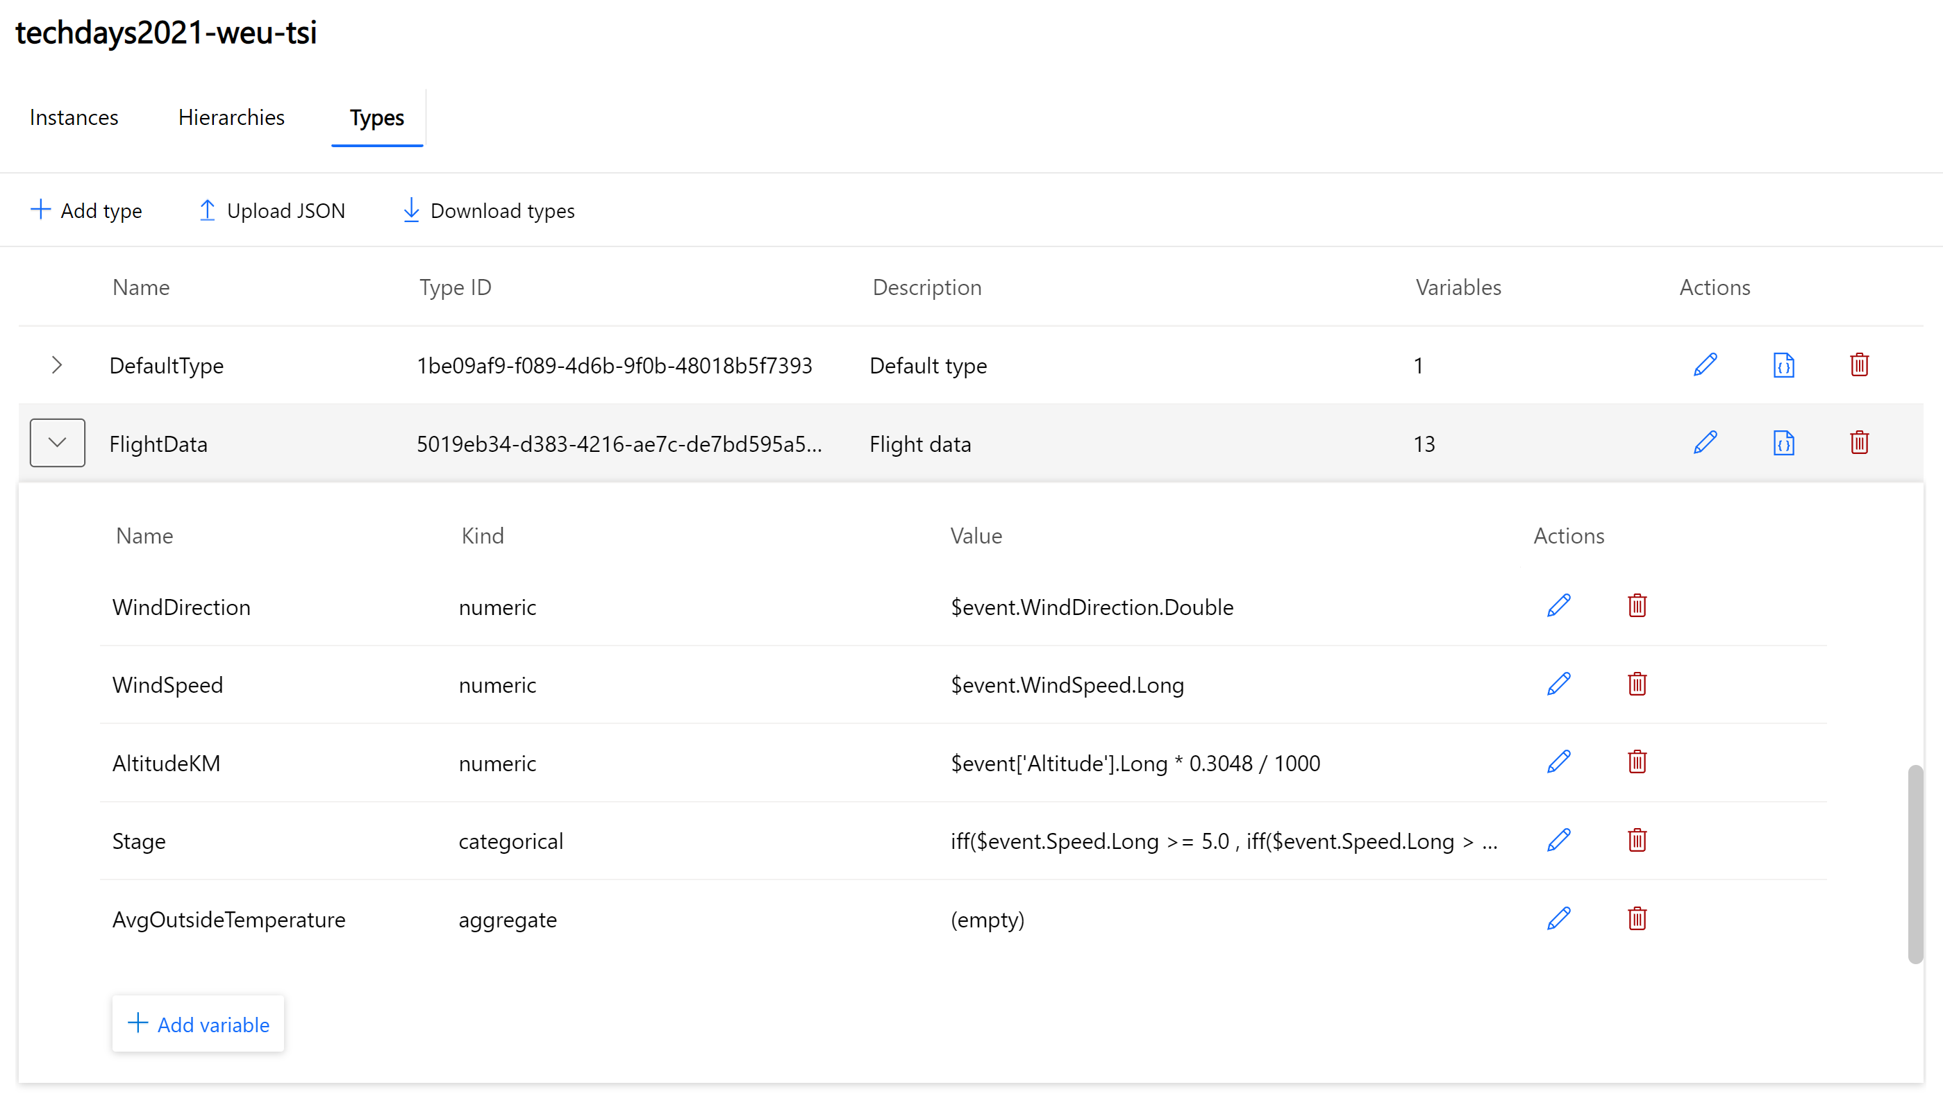
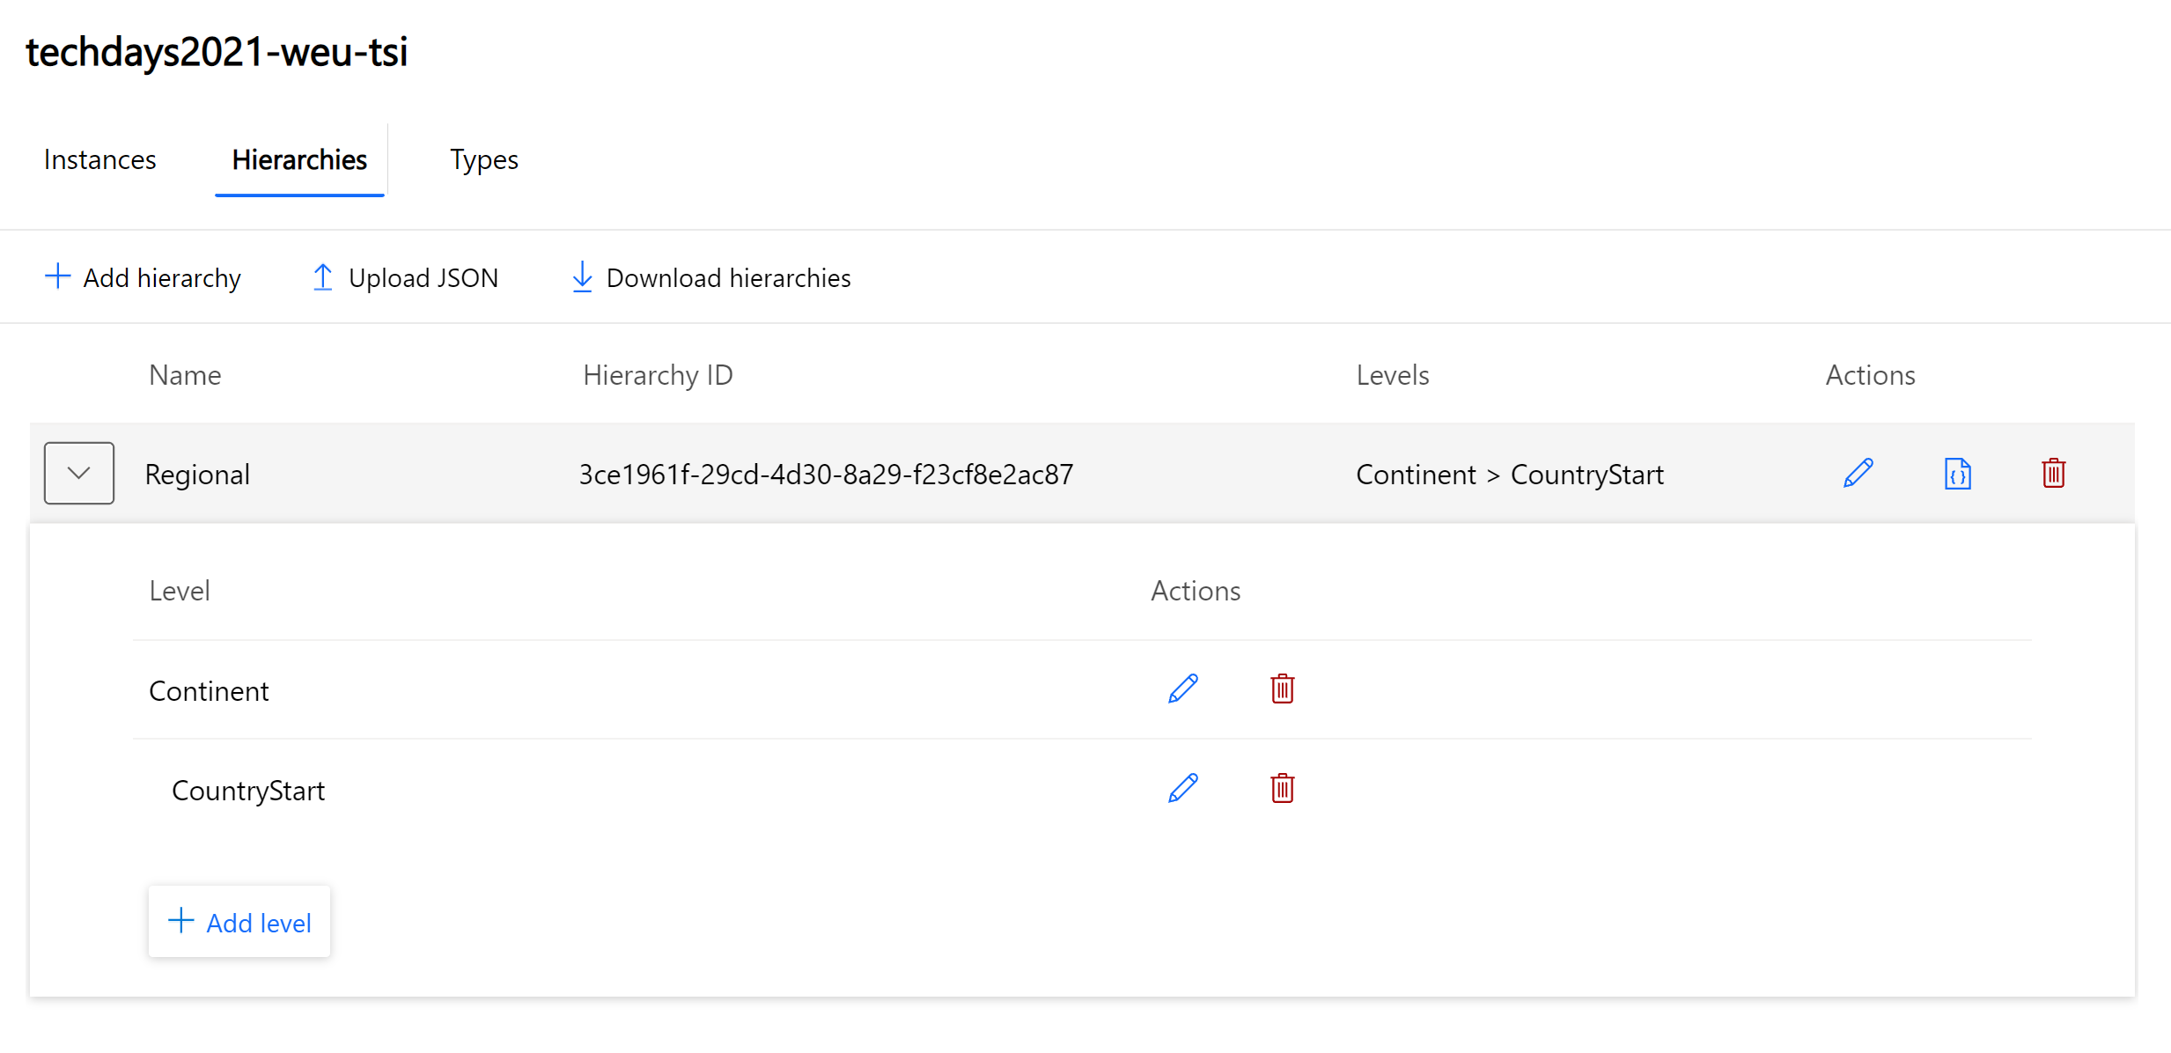
Demo
@svelde

Slide 10
Uncovering the why:
Anomaly detection and diagnosis
Examples:
Understanding why equipment requires extra maintenance
Searching why inventory was damaged
Researching why production declined on an assembly line
Chasing down a defect in the supply chain process
3rd Party IoT apps using Time Series Insights APIs
Query API
Time Series Insights JavaScript SDK
IoT device, gateway, and application data
Azure IoT Hub
Time Series Insights
SEEN IN DEMO
Time Series Insights Explorer
SEEN IN DEMO
@svelde

Slide 11






Improving operations:
Operational intelligence and advanced analytics
Examples:
Monitor equipment performance at scale
Identify process inefficiencies
Diagnose the health of equipment
Optimize supply chain and production
3rd Party IoT apps using Time Series Insights APIs
Query API
Time Series Insights JavaScript SDK
IoT device, gateway, and application data
Azure IoT Hub
Time Series Insights
Time Series Insights Explorer
Advanced Analytics
Azure Batch
Databricks
Machine Learning
Self serve models
Predictive AI dashboards
Statistical analysis
@svelde

Slide 12

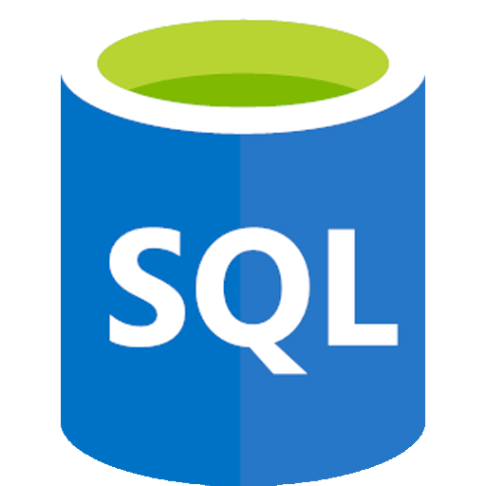
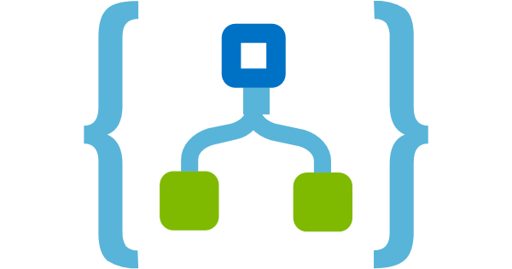

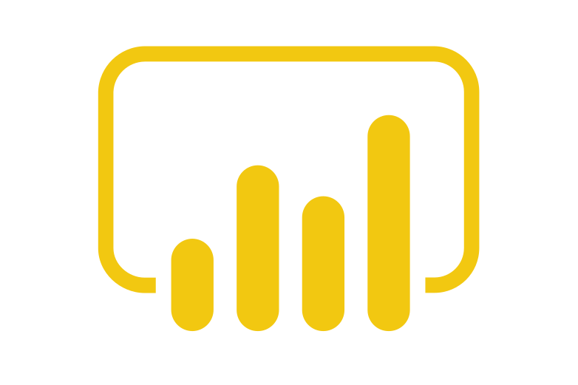




Stream processing
Improving operations:
Operational intelligence and advanced analytics
Operational efficiency
Power
BI
Azure SQL
Azure Logic App
Azure Functions
Real time dashboards
Examples:
Monitor equipment performance at scale
Identify process inefficiencies
Diagnose the health of equipment
Optimize supply chain and production
Azure Stream Analytics
Event Hubs
Real time applications
Query API
IoT device, gateway, and application data
Azure IoT Hub
Time Series Insights
Time Series Insights Explorer
Advanced Analytics
Business systems (structured)
Azure Batch
Databricks
Machine Learning
Self serve models
Predictive AI dashboards
Statistical analysis
@svelde

Slide 13
Call to Action
Links with further resources:
Azure IoT Show – Deep Dive
https://channel9.msdn.com/Shows/Internet-of-Things-Show/Deep-Dive-Analyzing-IoT-data-using-Time-Series-Insights
Time Series Insight Documentation
https://docs.microsoft.com/en-us/azure/time-series-insights/
MS Learn module
https://docs.microsoft.com/en-us/learn/modules/explore-analyze-time-series-insights/
AZ 220 Reference
https://docs.microsoft.com/en-us/learn/certifications/exams/az-220
@svelde

Slide 14
Q&A
How do you add insights?
@svelde

Slide 15
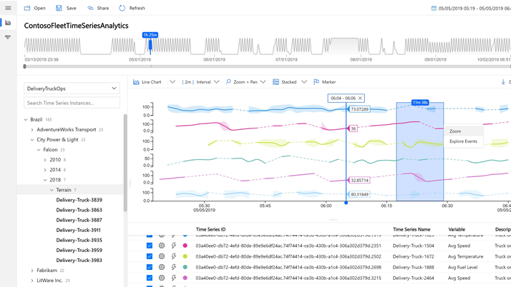
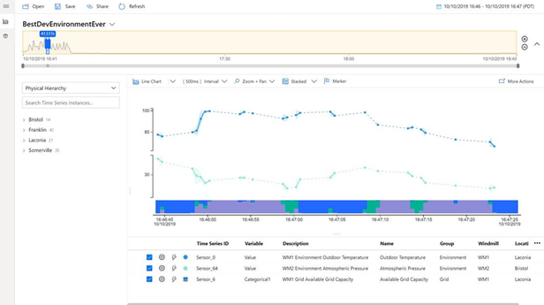
Azure Time Series Insights
Key capabilities
Multi-layered storage with warm and cold analytics support allowing customers to store data on warm store for interactive analytics over short timespans and to cold store for operational intelligence over decades of historical data
Data contextualization allows customers to describe the domain and metadata associated with the derived and raw signals from assets and devices
Flexible data platform that allows customers to take data stored in open-source Apache Parquet to other advanced data analytics solutions such as Spark, Databricks, machine learning, and AI
Rich query APIs and user experience to support signal reconstruction for missing data, reduction operations, discrete signal processing, scatter plots, and time shifting of time series signals for in-depth analysis
Enterprise-grade scale and performance at all layers of the solution to support customers’ industrial IoT solution needs
Rich extensibility through powerful connectors enables customers to take their time series data and consume them with other business systems
@svelde

